Slide 1

Alkoholpolitiskt Forum
FREDRIK WOODS
2023-10-19

Slide 2
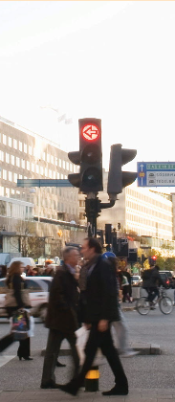
The support for alcohol policy in Sweden
RARHA-SEAS-study | Strongly agree | Somewhat agree | Somewhat disagree | Strongly disagree
The number of places selling alcoholic beverages should be kept low in order to reduce alcohol-related harm | 34,8 (22.9) | 32,1 (26.2) | 13,7 (26.0) | 19,4 (21.7)
Prices of alcoholic beverages should be kept high in order to reduce alcoholrelated harm | 22,9 (21.2) | 37,2 (24.8) | 14,3 (26.3) | 25,6 (24.6)
Advertising of alcoholic beverages should be banned | 38,5 (32.7) | 28,6 (24.4) | 12,0 (23.4) | 20,8 (16.1)
Printed warnings about alcohol-related harm should be displayed on alcohol packaging | 53,3 (45.3) | 27,5 (30.1) | 7,5 (12.9) | 11,8 (9.1)
There should be limits on how late in the evening you can buy alcoholic beverages | 35,2 (28.0) | 28,5 (24.5) | 17,2 (21.3) | 19,1 (23.1)

Slide 3
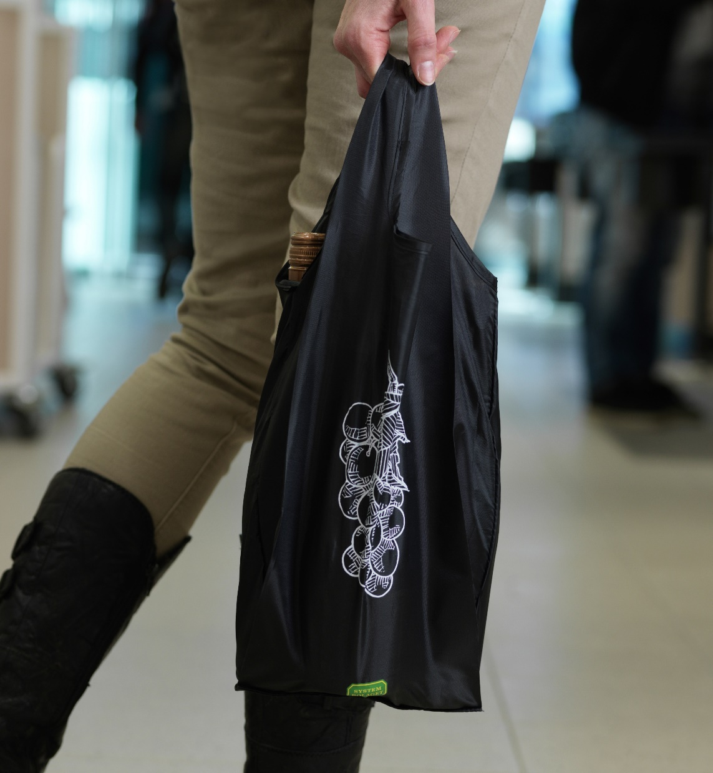
Alkoholindex 2023
 | Agree | Disagree
The number of places selling alcoholic beverages should be kept low in order to reduce alcohol-related harm | 55 (67) | 28 (33)
Prices of alcoholic beverages should be kept high in order to reduce alcoholrelated harm | 47 (60) | 31 (40)
Advertising of alcoholic beverages should be banned | 56 (67) | 23 (40)
Printed warnings about alcohol-related harm should be displayed on alcohol packaging | 60 (81) | 18 (19)
There should be limits on how late in the evening you can buy alcoholic beverages | 54 (64) | 27 (36)

Slide 4
”Printed warnings about alcohol-related harm should be displayed on alcohol packaging.” Share agreeing to some extent, by region (2023).

Slide 5

Awareness of alcohol harms
 | Agree | Disagree
Alcohol can be harmful to your helath | 96 | 1
Alcohol is addictive | 94 | 1
Alcohol can cause cancer | 50 | 6
Drinking alcohol at an early age increases the risk for alcohol problems | 79 | 5

Slide 6
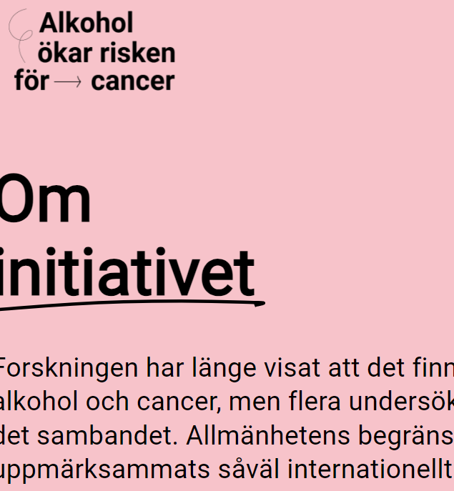
A closer look on public awareness on alcohol and cancer link
A majority (71%) think that high alcohol consumption can increase the risk of cancer
Few think that low (10%) alcohol consumption can increase the risk of cancer
If they new alcohol – at any level – could cause cancer some would change behavior:
  7% would stop drinking alcohol
  35% would lower their consumption
  13% would stop serving alcohol
  20% would serv less and/or on fewer occassions
  19% would advise friends and relatives not to drink alcohol consumption
Notes:
)

Slide 7

Health Warnings and EU
Systembolaget follows closely the regulatory development in other countries and in the EU.
Ireland
Mandatory labelling of the list of ingredients and nutrition declaration on alcoholic beverage products (
Health warnings on alcoholic beverage products part of Europe’s beating cancer plan
Plan for a commission proposal during 2023 – still no sign
In parallell the industry is developing its own (digital) solutions.

