Slide 1
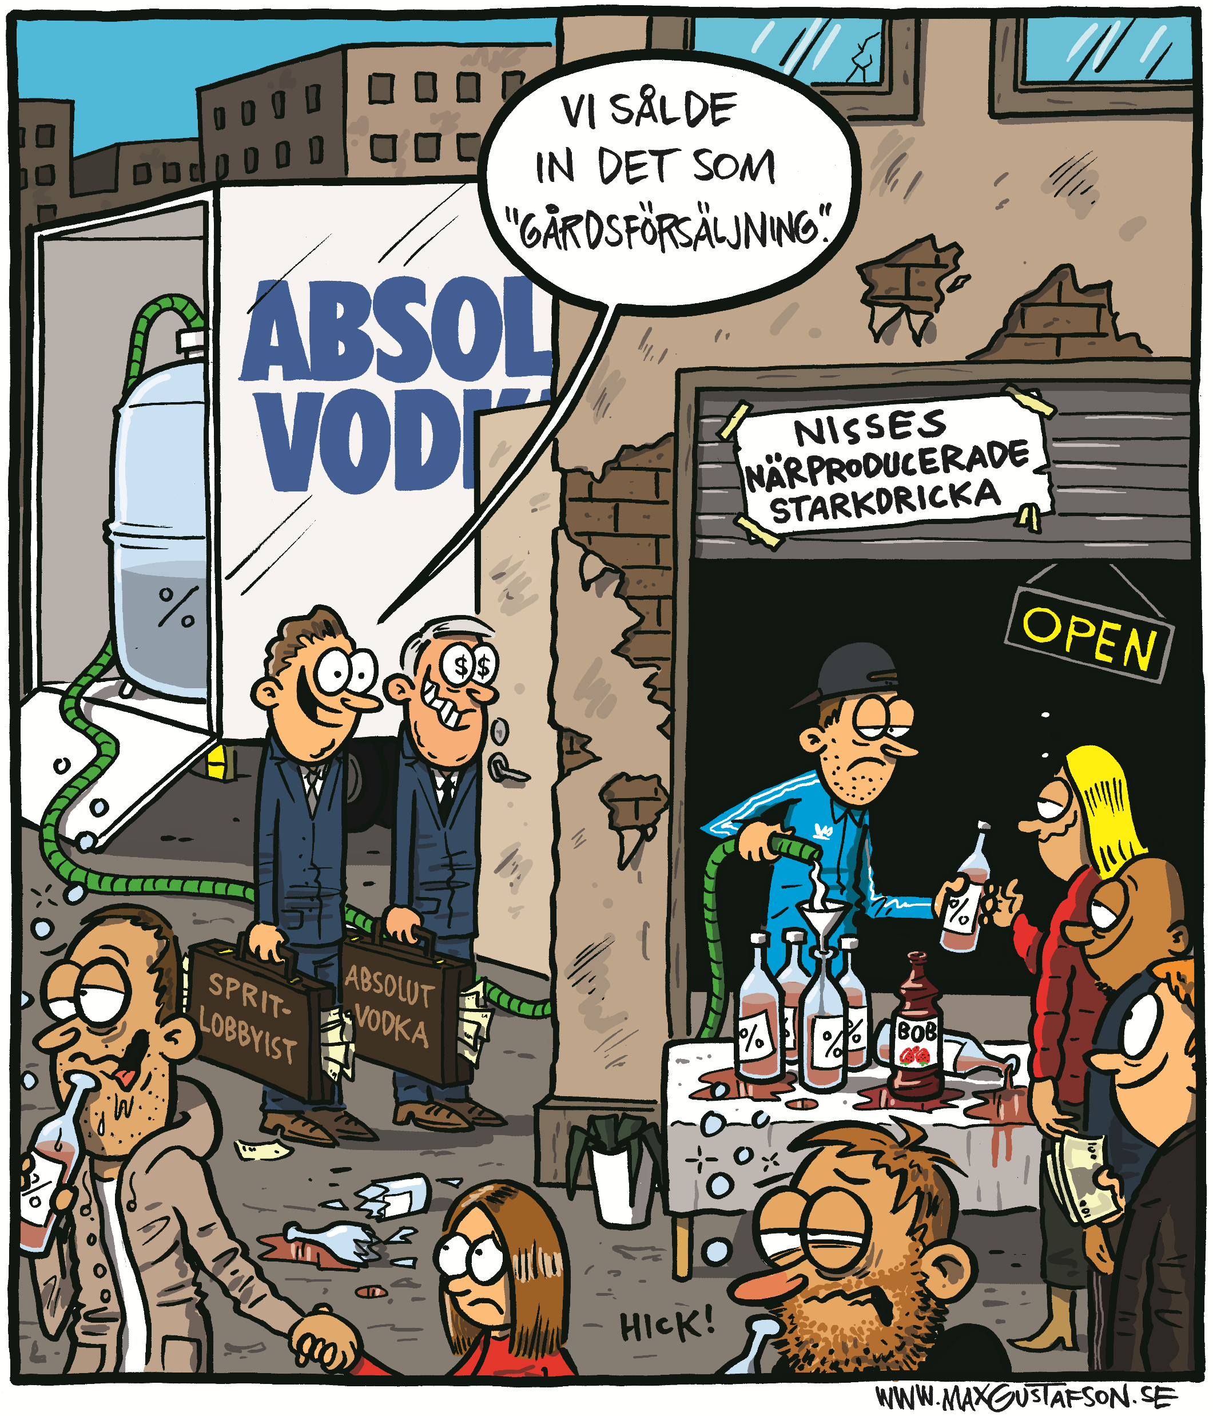

Farm sales and the alcohol industry
How does the industry operate in the farm sales question?

Slide 2
Disposition
Short background of yard sales
IOGT-NTO´s work with the issue
The industry and yard sales – how does the industry act?
Summary
Questions

Slide 3
Background
The issue of farm sales has existed in Sweden since the early 2000s and has already been inquiried twice, 2007 and in 2010.
Both of these inquiries concluded that it is not possible to combine farm sales with the state monopoly.
The main discussion has centered around EU legality of the proposal
In the so called ”January deal” the parties agreed to inquire the issue on third time.
The third inquiry is set to be presented on the 8th of december 2021.

Slide 4
IOGT-NTO and Farm sales
IOGT-NTO has opposed the initative since its beginning
The issue of farm sales might sound harmless but is in fact a much larger liberalisation of swedish alcohol policy than many assume.
It has been reported that some proponents of Farm Sales see this as a chance to indirectly bring down the alcohol monopoly.
Since the question once again returned, IOGT-NTO published a report last year named ”Farm sales – the trojan horse of the alcohol industry”.

Slide 5
Farm sales
The Trojan Horse of the Alcohol Industry
The report was produced in an effort to increase knowledge about Farm sales and its implications on society as a whole.
An attempt to move the question away from simply discussing the monopoly and EU-legislation.
The report also closer studies the proponents for the issue.
Conclusion:
Farm sales is a smart bluff by the alcohol industry

Slide 6
Why is Alcohol industry interested in Farm sales?

Slide 7
Why is Big Alcohol interested in Farm sales?
It gives them an opportunity to expand their brand
It opens up for new business opportunities
It undermines the monopoly which, in the future, strenghten the possibility for private sales.

Slide 8
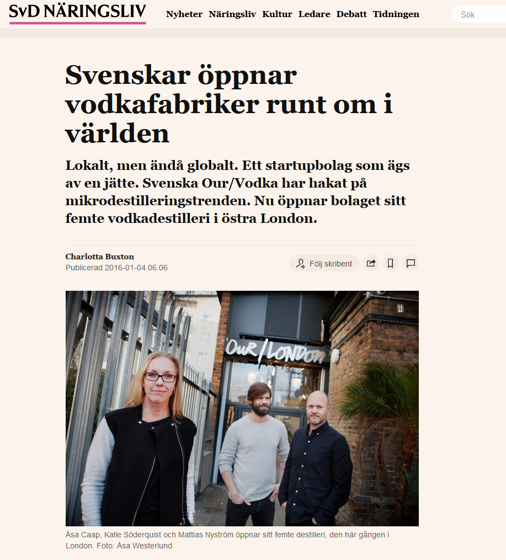

Slide 9
Why is Big Alcohol interested in Farm sales?
It gives them an opportunity to expand their brand
It opens up for new business opportunities
It undermines the monopoly which, in the future, strenghten the possibility for private sales.

Slide 10
What strategies do the alcohol industry use to promote Farm sales?

Slide 11
Control the ground
Spin the media
Engineer a following
Buy in credibility
Neutralize the opposition
Control the web
Sponsor a thinktank
Consult your critics
Open the door
Use revolving doors
Cave and Rowell, A Quiet Word; Tamasin Cave and Andy Rowell, ‘The Truth about Lobbying: 10 Ways Big Business Controls Government’, The Guardian, 2014

Slide 12
Control the ground
Spin the media
Engineer a following
Buy in credibility
Cave and Rowell, A Quiet Word; Tamasin Cave and Andy Rowell, ‘The Truth about Lobbying: 10 Ways Big Business Controls Government’, The Guardian, 2014

Slide 13

Control the ground & Spin the media
Control the ground
Spin the media
Engineer a following
Buy in credibility
Common arguments for farm sales to strengthen its framing:
How it will benefit the country-side as well as Swedish tourism
How it will promote & strengthen Swedish beverage culture
How the change is of a very limited character and therefore has no health implications
That it can be combined with the monopoly
Very rarely discusses the details of the proposal

Slide 14
How has the framing affected?
Control the ground
Spin the media
Engineer a following
Buy in credibility
This framing has made the question focused on its commercial implications rather than its public health
It strengthens the idea of alcohol production as important for rural development
It has created a diffusion on who it would benefit and what a alcohol producer is.
Most Swedish producers are not located in on the country-side but in the cities – notable when discussed in the inquiry as well

Slide 15




The consultancy group – a good example of successful lobbying
4 from the industry: LRF, Visita, Föreningen Svenskt Vin och Sveriges Oberoende Småbryggerier
2 from civil society: CAN och IOGT-NTO
2 organisations with public health goals: Folkhälsomyndigheten och Systembolaget
2 organisations with commerical goals: Konkurrensverket and Kommerskollegium

Slide 16
How has the framing affected?
Control the ground
Spin the media
Engineer a following
Buy in credibility
This framing has made the question focused on its commercial implications rather than its public health
That alcohol production and strengthening rural areas are connected
It has created a diffusion on who it would benefit and what an alcohol producer is.
Most Swedish producers are not located in on the country-side but in the cities – notable when discussed in the inquiry as well

Slide 17
What do they want to propose?
Control the ground
Spin the media
Engineer a following
Buy in credibility
The proposed details differ from the communicated messages
The industry wants:
  No restrictions to different types of production
  No restrictions on location
  No restrictions on sales hours or other limitations

Slide 18


Examples:
”Begränsningar kring produktionsmetoder, försäljningsvolym eller företagsstorlek bör inte förekomma.
Alla dryckesslag skall inkluderas”
”Att begränsa till ”hantverksmässig produktion”, landsbygd eller små producenter blir svårt”

Slide 19
What are the implications for industry?
Control the ground
Spin the media
Engineer a following
Buy in credibility
The issue of farm sales has crowded out many other discussions on alcohol nationally
The question also strengthen the notion that alcohol harm is only limited to a small group of consumers.
It strengthens the idea of alcohol as a cultural product and not as a harming substance.
It further strengthens the view of the industry of being friends of the monopoly, a common strategy used in Sweden.

Slide 20
Following & Credibility
Control the ground
Spin the media
Engineer a following
Buy in credibility
The question is fronted by smaller, local producers while larger producers are in the back
Further, the industry has heavily lobbied for larger interest organisations to support the question
Svensk Näringsliv, Företagarna, LRF, Visita
Also trying to make sure the industry looks united on the issue, even when there are plenty of critics among the producers themselves

Slide 21
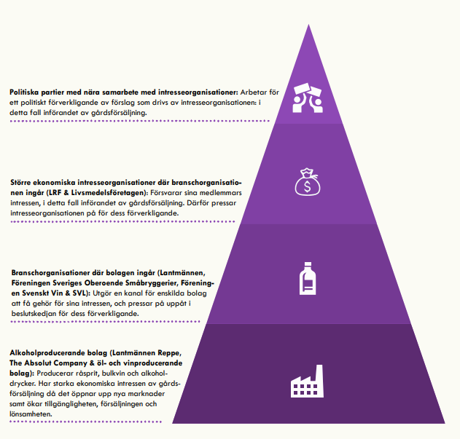

Slide 22


Following & Credibility
Control the ground
Spin the media
Engineer a following
Buy in credibility
The question is fronted by smaller, local producers while larger producers are in the back
Further, the industry has heavily lobbied for larger interest organisations to support the question
→ Svensk Näringsliv, Företagarna, LRF, Visita

Slide 23
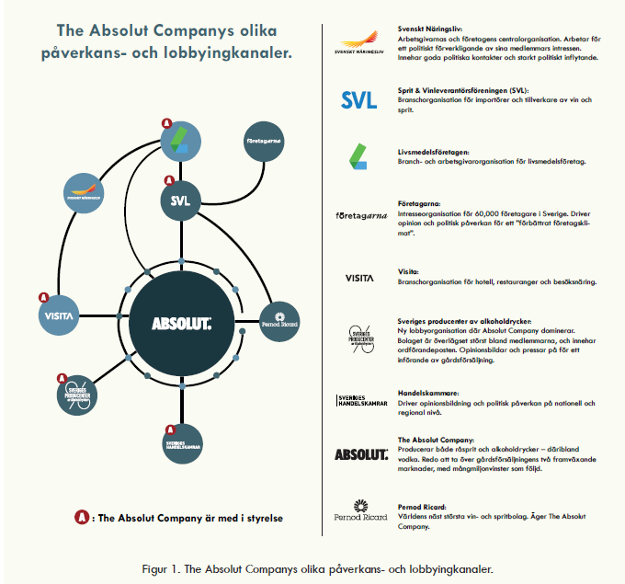

Slide 24
Following & Credibility
Control the ground
Spin the media
Engineer a following
Buy in credibility
The question is fronted by smaller, local producers while larger producers are in the back
Further, the industry has heavily lobbied for larger interest organisations to support the question
→ Svensk Näringsliv, Företagarna, LRF, Visita

Slide 25
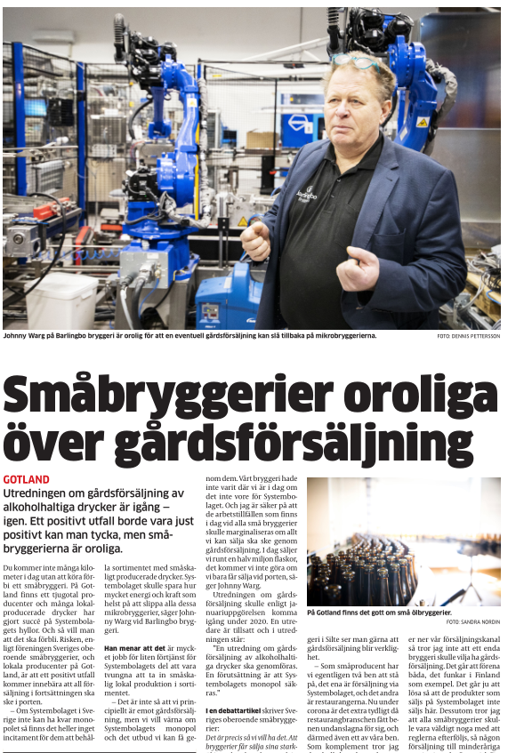


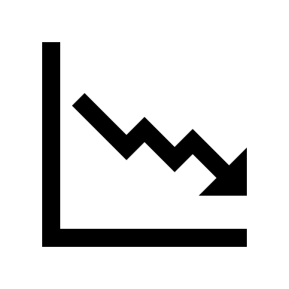
Following & Credibility
Control the ground
Spin the media
Engineer a following
Buy in credibility
Several small producers are worried
Many are dependent on the monopoly, and especially the ”TSLS-assortment
If the monopoly would fall it would greatly impact these producers

Slide 26
Summary
The industry has been very active in both promoting farm sales, as well as framing it
While the industry supports the issue, they are relying on other actors to spread the message.
While farm sales in itself would be a significant victory for the industry, just having the question on the table gives them value by:
    Including them in what is seen as grassroot-companies
    Conveying messages of alcohol being a cultural commodity instead of a harmful one.

Slide 27
Questions?
Emil Juslin
emil.juslin@iogt.se

